Slide 1
Course End Project

Slide 2
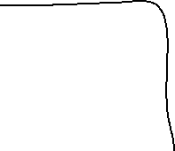

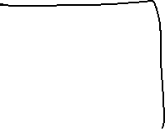







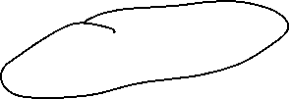

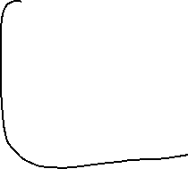




Slide 3
Steps
Create a VNet and a VM inside this VNet
Repeat Step 1 and create another vnet and vm
Do Vnet Peering between Vnet 1 and Vnet 2
Add a User in Azure Entra ID (Azure AD)
Create a custom role named Computer Operator
Grant this custom role to the newly created user on the RG which has all the resources

